Slide 1
Operating System
Tim Pengampu MK Sistem Operasi
Universitas Dian Nuswantoro

Slide 2
Memory Management
Is the task carried out by the OS and hardware to accommodate multiple processes in main memory
If only a few processes can be kept in main memory, then much of the time all processes will be waiting for I/O and the CPU will be idle
Hence, memory needs to be allocated efficiently in order to pack as many processes into memory as possible
In most schemes, the kernel occupies some fixed portion of main memory and the rest is shared by multiple processes

Slide 3
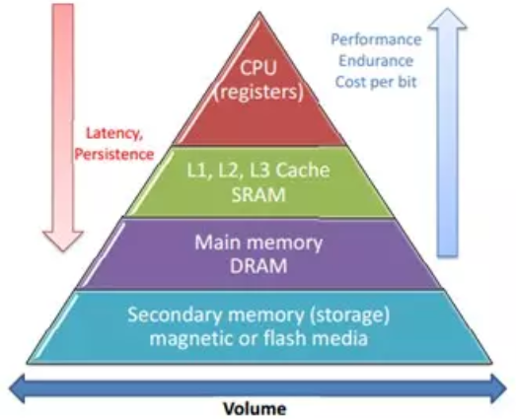
Memory Hierarchy

Slide 4
Memory Management Requirements
Relocation
programmer cannot know where the program will be placed in memory when it is executed
a process may be (often) relocated in main memory due to swapping
swapping enables the OS to have a larger pool of ready-to-execute processes
memory references in code (for both instructions and data) must be translated to actual physical memory address

Slide 5
Memory Management Requirements
Protection
processes should not be able to reference memory locations in another process without permission
impossible to check addresses at compile time in programs since the program could be relocated
address references must be checked at run time by hardware

Slide 6
Memory Management Requirements
Sharing
must allow several processes to access a common portion of main memory without compromising protection
cooperating processes may need to share access to the same data structure
better to allow each process to access the same copy of the program rather than have their own separate copy

Slide 7
Memory Management Requirements
Logical Organization
users write programs in modules with different characteristics
instruction modules are execute-only
data modules are either read-only or read/write
some modules are private others are public
To effectively deal with user programs, the OS and hardware should support a basic form of module to provide the required protection and sharing

Slide 8
Memory Management Requirements
Physical Organization
secondary memory is the long term store for programs and data while main memory holds program and data currently in use
moving information between these two levels of memory is a major concern of memory management (OS)
it is highly inefficient to leave this responsibility to the application programmer

Slide 9
Memory Management Classification
Real | Real |  |  | Virtual
(1) Single User System | Multi Programming System with Physical Memory |  |  | Multi Programming System with Virtual Memory
 | Multiprogramming with Static Partition |  | (4) Multi Programming with Dynamic Partition | (5) Paging System | (6) Segmentation System | (7) Paging and Segmentation Combination
 | (2) Absolute Placement | (3) Can be Relocated
(1), (2), (3), (4) → physical memory management, can not used to load bigger programs then available memory
(5), (6), (7) → used to trick for memory need, so it can load a bigger program which is need more memory then it is available

Slide 10
Simple Memory Management
In this chapter we study the simpler case where there is no virtual memory
An executing process must be loaded entirely in main memory (if overlays are not used)
Although the following simple memory management techniques are not used in modern OS, they lay the ground for a proper discussion of virtual memory (next chapter)
fixed / static partitioning
dynamic partitioning
Paging system
segmentation
combination paging system and segmentation

Slide 11
Memory Management without Swapping (Mono-programming)
OS
ROM
Device
Drivers
ROM
User
Prog
User
Prog
RAM
RAM
User
Prog
RAM
OS
OS
Mono-programming” -- No multiprocessing !
- Early efforts used “Swapping”, but it’s slow

Slide 12
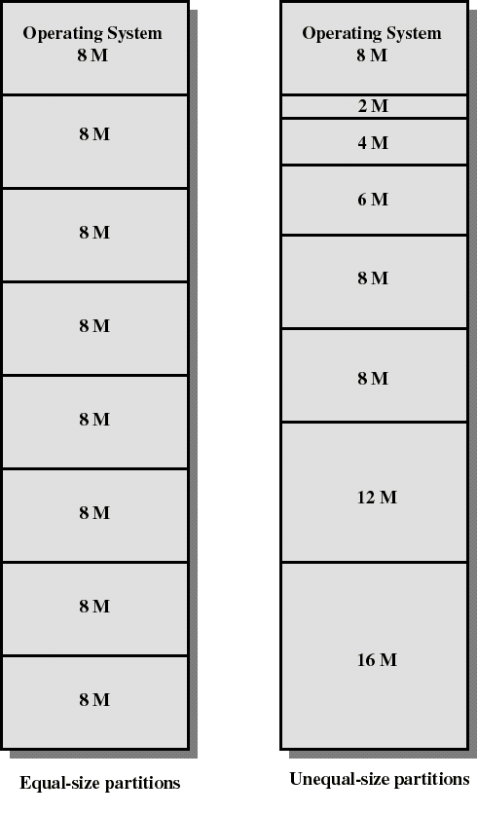
Memory Management without Swapping (Multiprogramming) Fixed / Static Partitioning
Partition main memory into a set of non overlapping regions called partitions
Partitions can be of equal or unequal sizes

Slide 13
Fixed Partitioning
any process whose size is less than or equal to a partition size can be loaded into the partition
if all partitions are occupied, the operating system can swap a process out of a partition
a program may be too large to fit in a partition. The programmer must then design the program with overlays
when the module needed is not present the user program must load that module into the program’s partition, overlaying whatever program or data are there

Slide 14
Fixed Partitioning
Main memory use is inefficient. Any program, no matter how small, occupies an entire partition. This is called internal fragmentation.
Unequal-size partitions lessens these problems but they still remain...
Equal-size partitions was used in early IBM’s OS/MFT (Multiprogramming with a Fixed number of Tasks)

Slide 15
Placement Algorithm with Partitions
Equal-size partitions
If there is an available partition, a process can be loaded into that partition
because all partitions are of equal size, it does not matter which partition is used
If all partitions are occupied by blocked processes, choose one process to swap out to make room for the new process

Slide 16
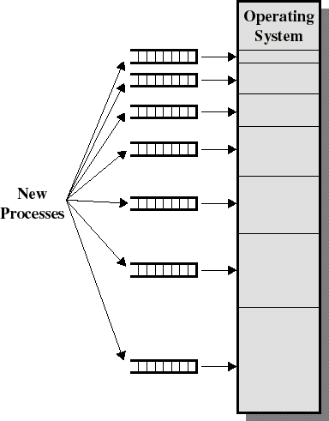
Placement Algorithm with Partitions
Unequal-size partitions: use of multiple queues
assign each process to the smallest partition within which it will fit
A queue for each partition size
tries to minimize internal fragmentation
Problem: some queues will be empty if no processes within a size range is present

Slide 17
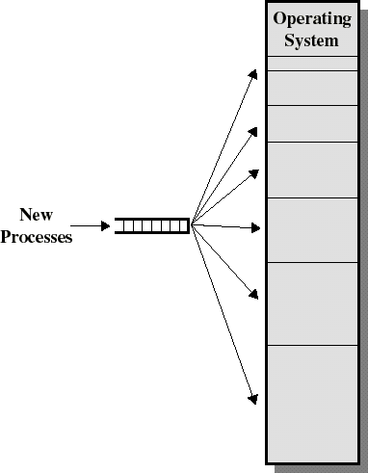
Placement Algorithm with Partitions
Unequal-size partitions: use of a single queue
When its time to load a process into main memory the smallest available partition that will hold the process is selected
increases the level of multiprogramming at the expense of internal fragmentation

Slide 18

Any Question ?
Anything to discuss ?

Slide 19
Dynamic Partitioning
Partitions are of variable length and number
Each process is allocated exactly as much memory as it requires
Eventually holes are formed in main memory. This is called external fragmentation
Must use compaction to shift processes so they are contiguous and all free memory is in one block
Used in IBM’s OS/MVT (Multiprogramming with a Variable number of Tasks)

Slide 20
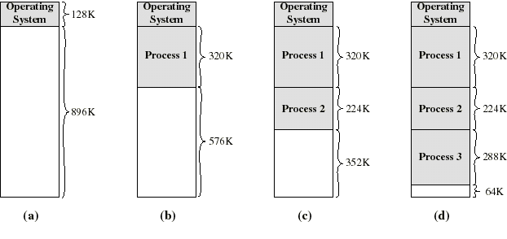
Dynamic Partitioning: an example
A hole of 64K is left after loading 3 processes: not enough room for another process
Eventually each process is blocked. The OS swaps out process 2 to bring in process 4

Slide 21
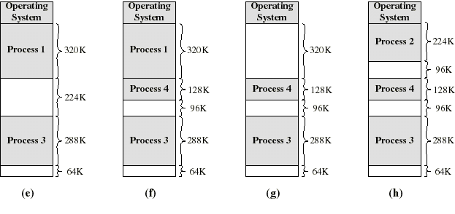
Dynamic Partitioning: an example
another hole of 96K is created
Eventually each process is blocked. The OS swaps out process 1 to bring in again process 2 and another hole of 96K is created...
Compaction would produce a single hole of 256K

Slide 22
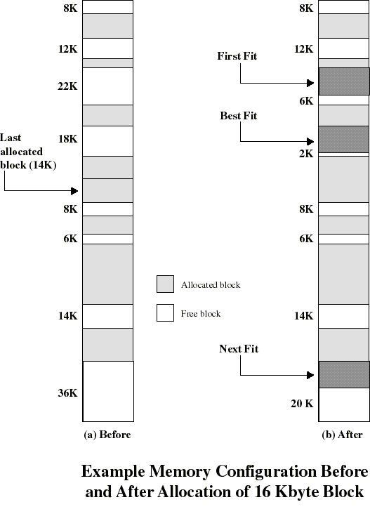
Placement Algorithm
Used to decide which free block to allocate to a process
Goal: to reduce usage of compaction (time consuming)
Possible algorithms:
Best-fit: choose smallest hole
First-fit: choose first hole from beginning
Next-fit: choose first hole from last placement

Slide 23
Best-fit algorithm
Chooses the block that is closest in size to the request
Since smallest block is found for process, the smallest amount of fragmentation is left
Lot of little holes …
Memory compaction must be done more often
Notes:
23

Slide 24
First-fit algorithm
Scans memory form the beginning and chooses the first available block that is large enough
Fastest
May have many process loaded in the front end of memory that must be searched over when trying to find a free block
Notes:
24

Slide 25
Next-fit algorithm
Scans memory from the location of the last placement
More often allocate a block of memory at the end of memory where the largest block is found
The largest block of memory is broken up into smaller blocks
Compaction is required to obtain a large block at the end of memory
Notes:
25

Slide 26
Placement Algorithm: some comments
Next-fit often leads to allocation of the largest block at the end of memory
First-fit favors allocation near the beginning: tends to create less fragmentation then Next-fit
Best-fit searches for smallest block: the fragment left behind is small as possible
main memory quickly forms holes too small to hold any process: compaction generally needs to be done more often

Slide 27
Other Placement Algorithm
Worst-fit
Find and choose the largest block available
Not the best idea to use it
Quick-fit
Used only for linked-list memory placement
Can be use to speed up the other algorithm to find a hole and placing the process
Memory deallocation become more complex and more slow because the free memory had to be moved from process list to hole list

Slide 28
Exercise
Notes : Memory that already used are greyed out !
New process with size of 6 Kb is arrive and where it will be place with the algorithm :
Next Fit (last position on H5)
Best Fit
First Fit
Worst Fit

Slide 29
Buddy System
The Buddy System is a memory allocation that works on the basis of using binary numbers as these are fast for computers to manipulate.
Entire space available is treated as a single block of 2^U
If a request of size s such that
2^(U-1) < s <= 2^U
entire block is allocated
Otherwise block is split into two equal buddies
Process continues until smallest block greater than or equal to s is generated
Lists are maintained which stores lists of free memory blocks of sizes 1, 2, 4, 8,…, n, where n is the size of the memory (in bytes). This means that for a one megabyte memory we require 21 lists.
If we assume we have one megabyte of memory and it is all unused then there will be one entry in the 1M list; and all other lists will be empty.

Slide 30
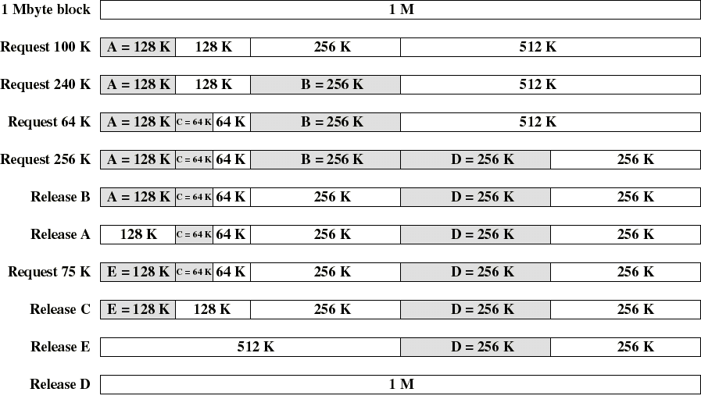
Example of Buddy System

Slide 31
Buddy System
Programs are not moved in memory
simplifies memory management
The buddy system is fast as when a block size of 2k bytes is returned only the 2k list has to be searched to see if a merge is possible. (Mostly efficient when the size M of memory used by the Buddy System is a power of 2)
The problem with the buddy system is that it is inefficient in terms of memory usage. All memory requests have to be rounded up to a power of two
This type of wastage is known as internal fragmentation. As the wasted memory is internal to the allocated segments.
On average, internal fragmentation is 25%
each memory block is at least 50% occupied
Opposite is external fragmentation where the wasted memory appears between allocated segments.

Slide 32
Exercise (Buddy System)
Request 85 K
Request 45 K
Request 75 K
Release A
Request 55 K
Release B
Release D
Release C

Slide 33
Any Question ?
Anything to discuss ?

